Slide 1
A guide to plotting in R 30th April 2013
BRC MH Bioinformatics team:
Steve Kiddle, Caroline Johnston, Amos Folarin, Steve Newhouse, Jen Mollon

Slide 2
Programme
Brief review of required R knowledge
The basics - plot()
More simple plots – histograms, boxplots, plotting data points
Heatmaps, dendograms/clustering
Forest plots, density plots, plotting lines (best fit, lowess)
Formatting and exporting
Useful GWAS plots (Manhattan, QQ plots)
Interactive plots, 'playwith' package (plotting interface)

Slide 3
Review & basic plot() function
Jen Mollon

Slide 4
The iris data - review
data(iris)

Slide 5
The iris data - review
Summarise data:
Select columns using column name or number:
Call a function – function.name(parameters)

Slide 6
R: Reference card
http://cran.r-project.org/doc/contrib/Short-refcard.pdf
"Short" 4-page reference card:
accessing help
input/output
selecting, extracting, manipulating data
strings, basic math/stats functions, model-fitting
plotting
programming tools: functions, conditioning

Slide 7
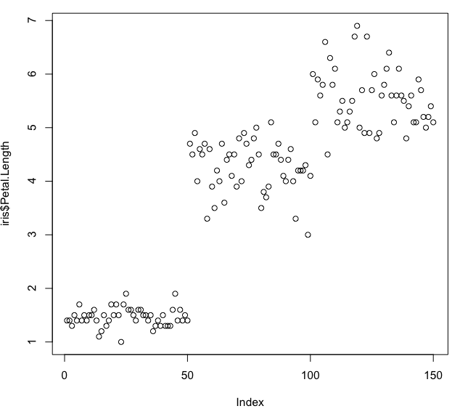
Behaviour of plot() –numeric variables
data(iris)
plot(iris$Petal.Length)
y-axis label is variable name
x-axis label is "Index" – row number of data frame

Slide 8
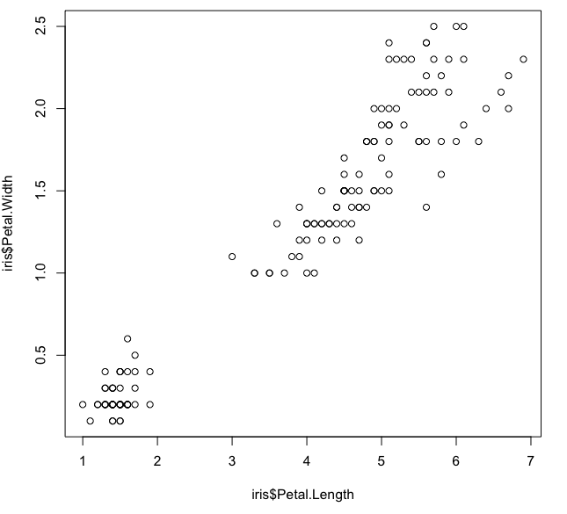
Behaviour of plot() –numeric variables
plot(iris$Petal.Length,iris$Petal.Width)
2 numeric variables: scatterplot

Slide 9
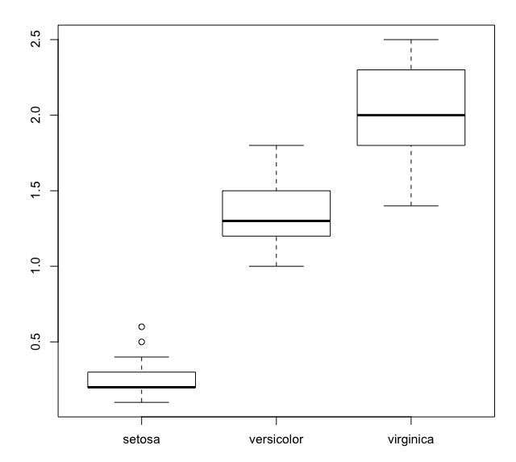
Behaviour of plot() –numeric/factor
plot(iris$Species,iris$Petal.Width)
Factor & numeric: boxplot
What happens if you switch the order? Try:
plot(iris$Petal.Width, iris$Species)

Slide 10
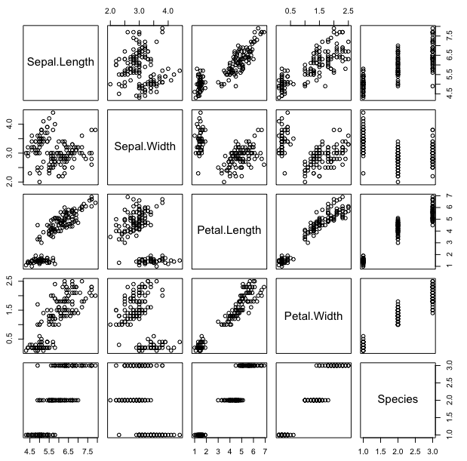
Behaviour of plot() – data frame
plot(iris)
Creates all pairwise scatterplots.
NOTE: Factor converted to numeric

Slide 11
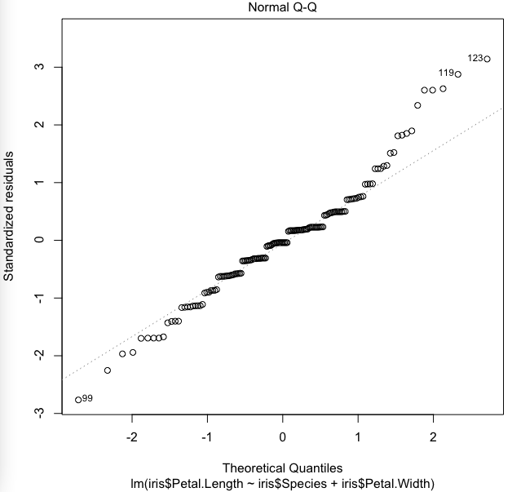
Behaviour of plot() - regression
fit<-lm(iris$Petal.Length~iris$Species+iris$Petal.Width)
summary(fit)
plot(fit)
<return> to go through
various diagnostic plots

Slide 12
Other plot() behaviours
pc_iris=prcomp(iris[,1:4])
plot(pc_iris)
group=sample(x=c("a","b","c","d","e","f","g","h","i","j"),size=500,replace=T)
plot(table(group))
methods(plot)

Slide 13
Simple plots, heatmaps, dendograms
Steve Kiddle

Slide 14
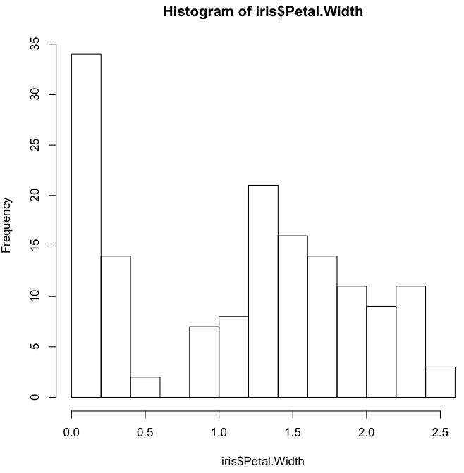
Histogram – examine distribution of variable
hist(iris$Petal.Width)

Slide 15
Boxplot – as shown earlier
plot(iris$Species,iris$Petal.Width)
Factor & numeric: boxplot
What happens if you switch the order? Try:
plot(iris$Petal.Width, iris$Species)

Slide 16
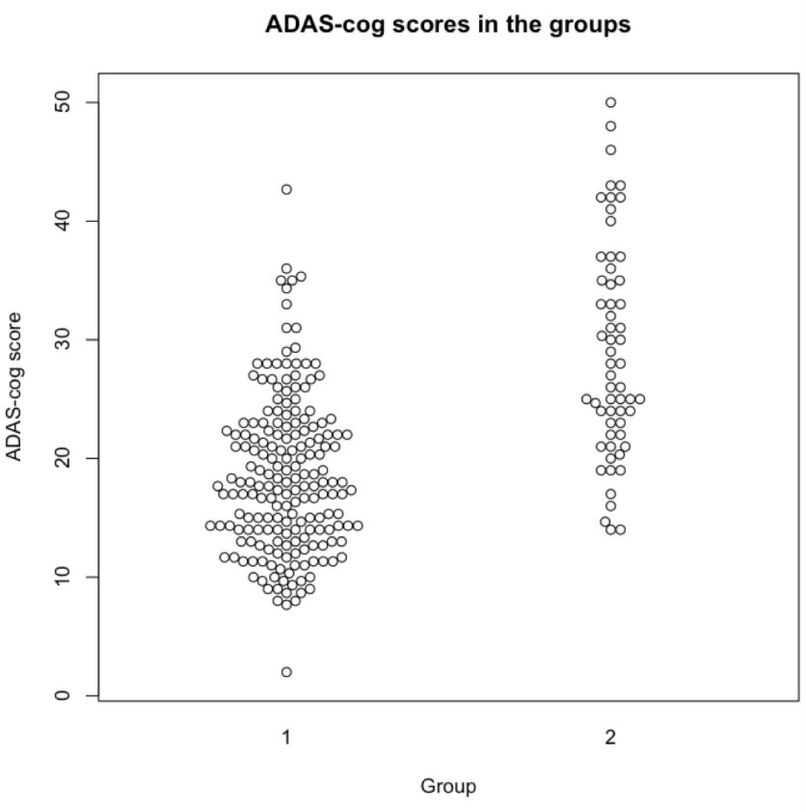
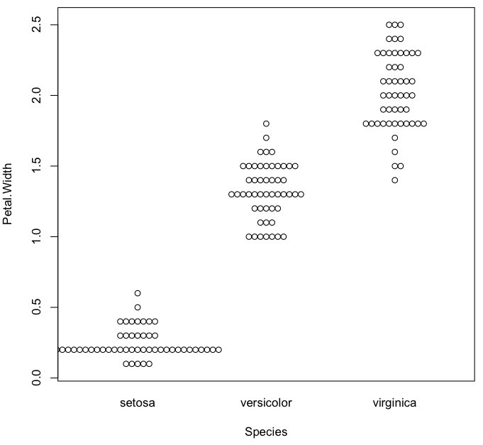
Beeswarm – boxplot equivalent showing raw data
install.packages('beeswarm')
library('beeswarm')
beeswarm(Petal.Width~Species,data=iris)
Another example

Slide 17
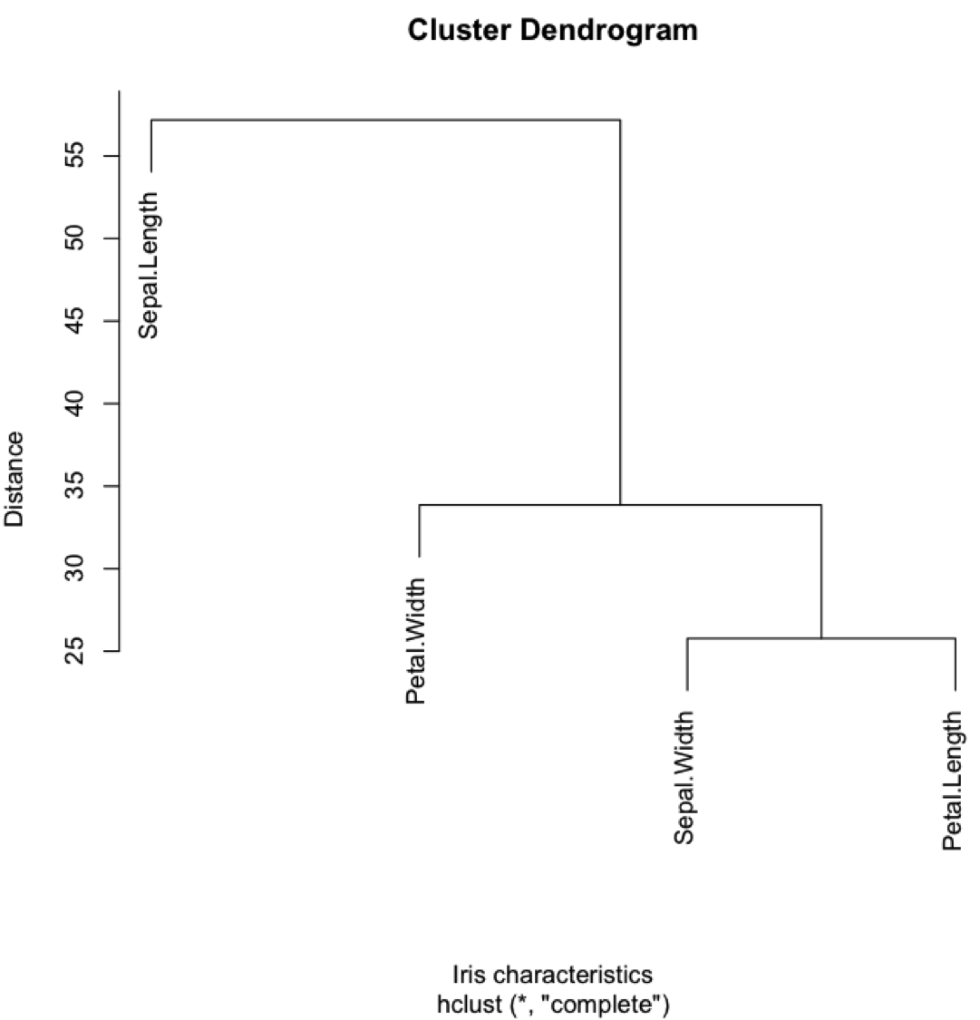
Hierarchical clustering – Euclidean distance
plot(hclust(dist(t(iris[,1:4]))),
xlab="Iris characteristics",
ylab="Distance")
What is each function
doing?

Slide 18
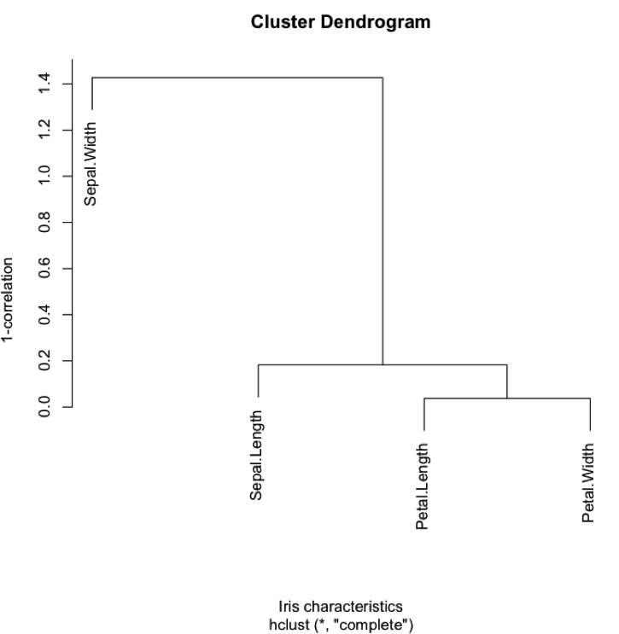
Hierarchical clustering – Euclidean distance
plot(hclust(as.dist(1-cor(iris[,1:4]))),
xlab="Iris characteristics",
ylab="1-correlation")
What is each function
doing?
Why is this result
different to the last?

Slide 19
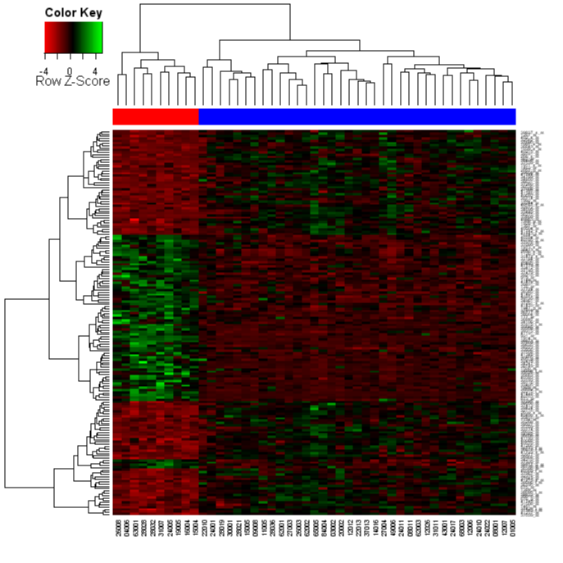
Drawing heatmaps with Heatmap.2
Introduction at:
www2.warwick.ac.uk/fac/sci/moac/people/students/peter_cock/r/heatmap/

Slide 20
Forest plots, density plots, adding lines
Amos Folarin

Slide 21
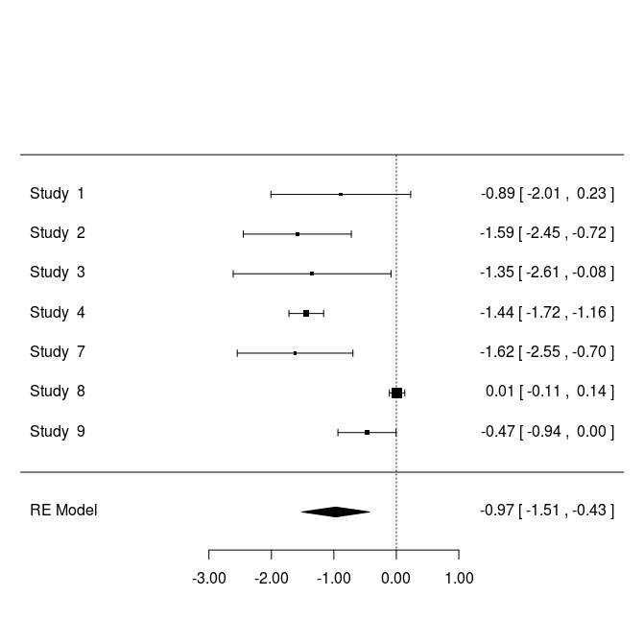
Forest Plot (metafor package)
A Forest Plot is a visualisation meta-analysis effect sizes. The metafor package allows you to calculate Effect Sizes and then fit fixed-, random-, and mixed-effects models to these Effect Sizes. (see help page: ?’metafor-package’)
For fixed- and random-effects models (i.e., for models without moderators), a polygon is added to the bottom of the forest plot, showing the summary estimate based on the model (with the outer edges of the polygon indicating the confidence interval limits).
a dotted line indicates the (approximate) bounds of the credibility interval
Effect Size, + Confidence Intervals, for single study
Effect Size (diamond-centre), + Confidence Intervals (diamond-horizontal), for Meta-analysis

Slide 22
Forest Plot (metafor package)
We’ll use the example dataset dat.bcg with the package “metafor”
dat.bcg: Is the results from 13 studies examining the effectiveness of the Bacillus Calmette-Guerin (BCG) vaccine for preventing tuberculosis.
*trial* ‘numeric’ trial number
*author* ‘character’ author(s)
*year* ‘numeric’ publication year
*tpos* ‘numeric’ number of TB positive cases in the treated (vaccinated) group
*tneg* ‘numeric’ number of TB negative cases in the treated (vaccinated) group
*cpos* ‘numeric’ number of TB positive cases in the control (non-vaccinated) group
*cneg* ‘numeric’ number of TB negative cases in the control (non-vaccinated) group
*ablat* ‘numeric’ absolute latitude of the study location (in degrees)
*alloc* ‘character’ method of treatment allocation (random, alternate, or systematic assignment)
2x2 table frequencies
 | Positive | Negative
Treated | Tpos (ai) | Tneg (bi)
Control | Cpos (ci) | Cneg (di)

Slide 23
Forest Plot (metafor package)
### load BCG vaccine data
data(dat.bcg)
# As a minimum, we need to provide a measure of Effect Size ( e.g.‘"RR"’ log relative risk, ‘"OR"’ log odds ratio, etc) and some Variance Measure. This can generally be provided with the escalc(…) function.
### calculate log relative risks and corresponding sampling variances
dat <- escalc(measure="RR", ai=tpos, bi=tneg, ci=cpos, di=cneg, data=dat.bcg)
### default forest plot of the observed log relative risks (is effectively rma(yi, vi, method="FE"))
x11(); forest(dat$yi, vi=dat$vi)
### forest plot of the observed relative risks – with some embellishment
x11(); forest(dat$yi, dat$vi, slab=paste(dat$author, dat$year, sep=", "), transf=exp, alim=c(0,2), steps=5, xlim=c(-2,3.5), refline=1)

Slide 24
Forest Plot (metafor package)
### Function to fit the meta-analytic fixed- and random-effects models with or without moderators via the linear (mixed-effects) model.
### random-effects model (method="REML" is default, so technically not needed)
x11()
res <- rma(yi, vi, data=dat, method="REML")
forest.rma(res)
### subgrouping versus using a single model with a factor (subgrouping provides
### an estimate of tau^2 within each subgroup, but the number of studies in each
### subgroup get quite small; the model with the allocation factor provides a
### single estimate of tau^2 based on a larger number of studies, but assumes
### that tau^2 is the same within each subgroup)
res.a <- rma(yi, vi, data=dat, subset=(alloc=="alternate"))
res.r <- rma(yi, vi, data=dat, subset=(alloc=="random"))
res.s <- rma(yi, vi, data=dat, subset=(alloc=="systematic"))
x11(); forest.rma(res.a)
x11(); forest.rma(res.r)
x11(); forest.rma(res)

Slide 25
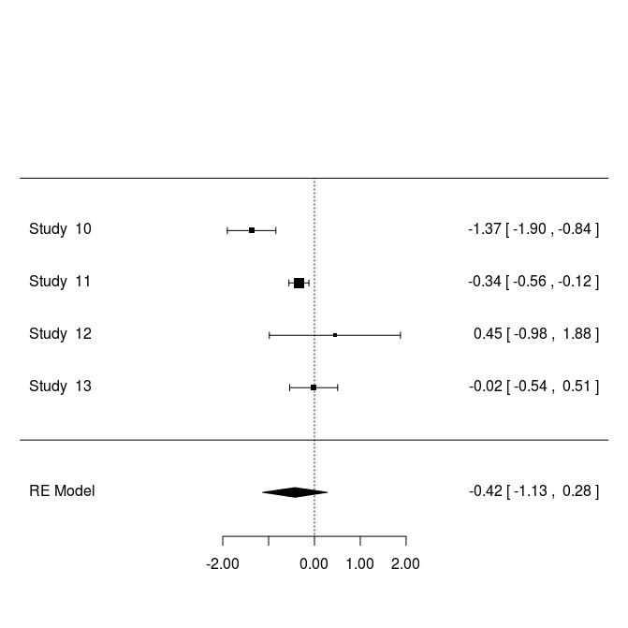
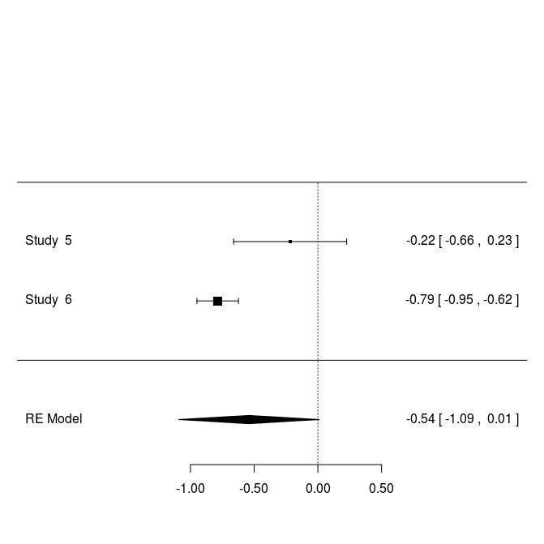
res.s (random)
res.s (systematic)
res.a (alternative)

Slide 26
ScatterPlots and Smooth Fits
Bi- and Tri-variate Relationships

Slide 27
Smoothed Lines of Fit (Line of Local Regression)
Visualisation using the scatter plots (via plot(x,y) or cars::scatterplot(x,y))
abline() provide a line of best fit
Smoothed local regression in R is provided by the LOESS functions
Note: there are two similarly named ones, don’t confuse them as they have different defaults!)
lowess() – older version
loess() – newer, formula based version

Slide 28
plot + lowess
### A basic scatterplot
### look at the dataset help page
?mtcars
### the default scatter plot
plot(mtcars$wt, mtcars$mpg,
main= "Car weight vs miles per gallon ",
xlab= "mpg Miles/(US) gallon ",
ylab= " wt Weight (lb/1000) "
)
abline(lm(mtcars$mpg~mtcars$wt), col="green", lty=2)
lines(lowess(mtcars$wt, mtcars$mpg), col="red", lty=1 )

Slide 30
car::scatterplot()
### a more sophisticated scatterplot in car package
### allows you to subset (e.g. here subset on 'Species')
library(car)
scatterplot(Sepal.Length~Petal.Length|Species, data=iris,
main="Iris Flower Sepal vs Petal Length",
boxplots="xy"
)
### also documentation for see:
?scatterplotMatrix

Slide 31
car::scatterplot()

Slide 32
3D scatterplots rgl:plot3d and Rcmdr:scatter3d
### To explore >2 dimensions as rotatable plots use one or the 3D plotting devices
library(rgl)
attach(iris)
plot3d(Sepal.Width,Sepal.Length,Petal.Length, col="red", size=5)
### or
library(Rcmdr)
attach(iris)
scatter3d(Sepal.Width,Sepal.Length,Petal.Length)

Slide 33
Interactive plots, plotting interface (playwith)
Cass Johnston

Slide 34
playwith library
install.packages("playwith")
Requires GTK+ 2.10.11 or later.
Will install automatically on Windows
On desktop linux, gtk2 is generally installed, but might need updated. I also had to install gtk2-devel on RHEL6.
See the playwith project page for a link to a Mac installer: https://code.google.com/p/playwith/

Slide 35
Regular R Plot
x<-1:100
y<-2*x+50
plot(x,y,pch=".")
R Plot in playwith
x<-1:100
y<-2*x+50
library(playwith)
playwith(plot(x,y )

Slide 36
Settings
Tools > Plot Settings
Set titles, axis labels, axes scales etc.

Slide 37
Style
Style >
Set point style, arrow style, brush style etc

Slide 38
New data
- reload and redraw
View> Redraw
Reload and redraw
Doesn't seem to be much difference between the two and I couldn't find any documentation.
It is possible to define callbacks that fire on initialisation and others that fire each time the plot is drawn, so there probably are differences when using certain tools.

Slide 39
labels
my.data<-data.frame(x,y)
rownames(my.data)<-paste("number_",x,sep="")
Click Identify
Click a point - Add label to point
Labels > Set Labels to> Data x values
Tools > Clear (or Shift+Del) clears the plot

Slide 40
brush
Select brush > click points to highlight.
Hold shift to add points to existing selection
Or click and drag to select a region of points
Or
Labels > Select from table to chose specific points to be brushed (ctrl to add to existing selection)
Style > Set brush style to change

Slide 41
Annotations and Arrows
Select Annotate
Click on the plot where you want the annotation
Enter the text
Select Arrow, click and drag on the plot where you want the arrow to go
Style > Set arrow style

Slide 42
Saving
File > Save
saves the plot as pdf
File > Save Code
saves the code that generated the plot as a runnable R script
Note that you'll need to have the relevant data loaded into your R environment (ie. my.data) for this to work.
I also found that I had to manually load a library to get it to work:
library(gridBase)
source("path/to/plot.R")

Slide 43
Advanced - add your own tools:
Define a function to be called by tool
hello_handler<-function(widget, playState){ gmessage("hello") }
Define a tool as a list.
The only required element is name, however there are many other options. For a full list:
?playwith
my.tool<-list(name="my.tool", label="Say Hello", callback=hello_handler)
tell playwith to use the tool
playwith(plot(my.data), tools=list(my.tool))
Not much documentation yet
More complex examples at https://code.google.com/p/playwith/
Click Here!

Slide 44
Applied R plotting : GWAS Manhattan Plot
Get R code for Manhattan Plot
https://sites.google.com/site/mikeweale/software/manhattan
Download : manhattan_v1.R
Save to working directory
Open it up in a text editor and look at instructions.
Do not make any changes!

Slide 45
GWAS Manhattan Plot
In R type:
source(“manhattan_v1.R”)
ls()
[1] "manhattan" "wgplot"
gwas <- read.table(“plink.assoc”,head=T)
head(gwas)
dim(gwas)
data_to_plot <- data.frame(CHR=gwas$CHR, BP=gwas$BP, P=gwas$P)
manhattan(data_to_plot, GWthresh=5e-8, GreyZoneThresh=1e-5, DrawGWline=FALSE)

Slide 46
GWAS Manhattan Plot

Slide 47
GWAS Manhattan Plot
Exporting plots
PDF
pdf("my_first_MH_plot.pdf",width=8,height=6)
manhattan(data_to_plot, GWthresh=5e-8, GreyZoneThresh=1e-5, DrawGWline=FALSE)
dev.off()
TIFF (publication)
tiff(filename="my_first_MH_plot.tiff",res=300,width=6, height = 3,units="in")
manhattan(data_to_plot, GWthresh=5e-8, GreyZoneThresh=1e-5, DrawGWline=FALSE)
dev.off()

